Slide 1
Power Analysis

Slide 2
Outline
1.Why power analysis is important
2.What is power
3.Caculating the Power
4.Caculating the sample size
5.Using R to calculate the power and sample size

Slide 3
1.Why power analysis is important
There are two goals of power analysis:
(a) how large a sample is needed to make statistical judgments to be accurate and reliable.
(b) how likely our statistical test to detect effects in an experiment.

Slide 4
2.What is power
To understand power, it is helpful to review what inferential statistics test:
Null hypothesis ( H0) : This hypothesis predicts that your experiment will not have an effect on your variable of interest.
Alternate hypothesis (H1):This hypothesis predicts that you will find a difference between groups.
Statistical tests look for evidence that you reject the null hypothesis and conclude that your experiment had an effect.

Slide 5
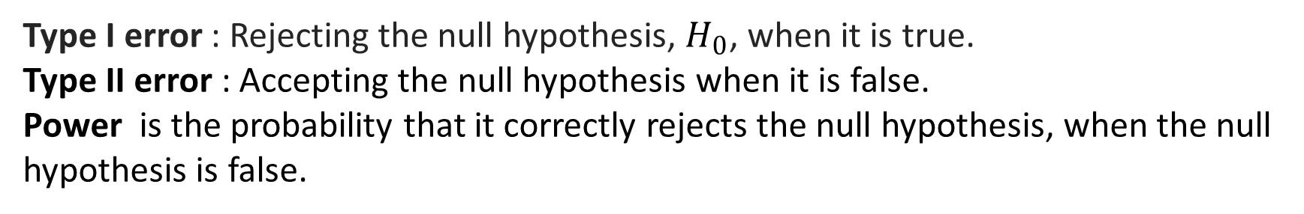
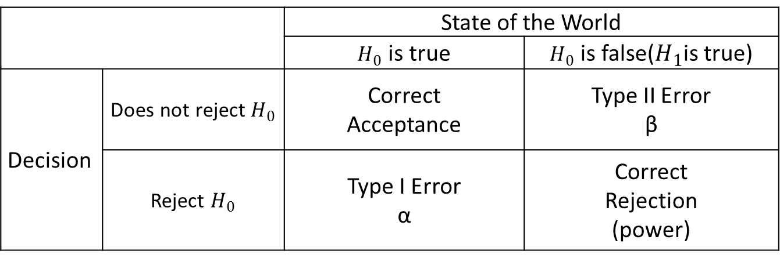
2.What is power
When undergoing the statistical test, there are 4 possible things can happen:
 |  | State of the World
 |  | $H_{0}$ is true | $H_{0}$ is false($H_{1}$is true)
Decision | Does not reject $H_{0}$ | Correct Acceptance | Type II Error β
 | Reject $H_{0}$ | Type I Error α | Correct Rejection (power)
Type I error : Rejecting the null hypothesis, $H_{0}$, when it is true.
Type II error : Accepting the null hypothesis when it is false.
Power is the probability that it correctly rejects the null hypothesis, when the null hypothesis is false.

Slide 6
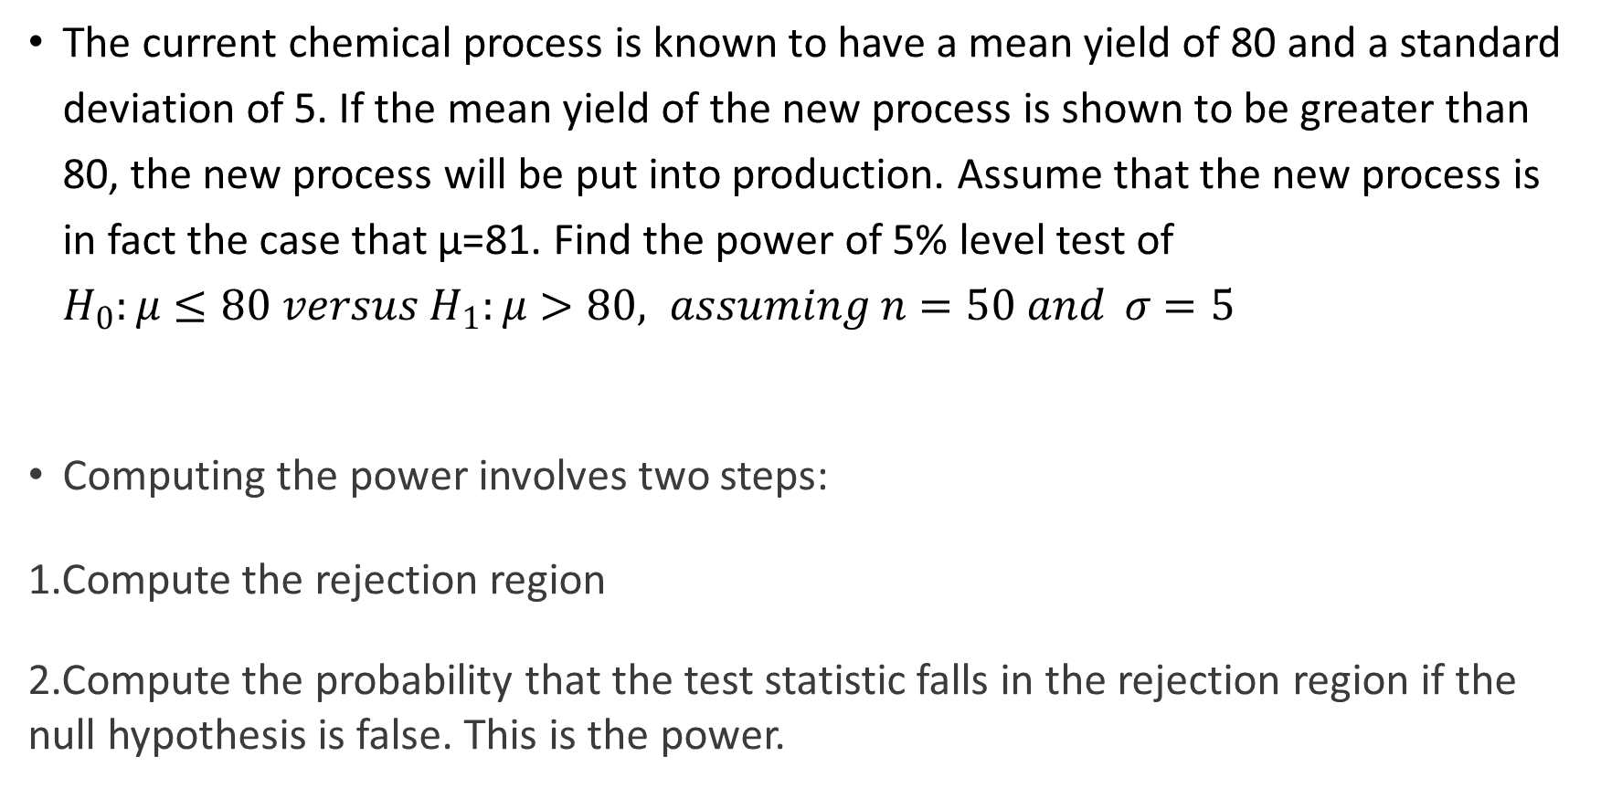
3.Caculating the Power
The current chemical process is known to have a mean yield of 80 and a standard deviation of 5. If the mean yield of the new process is shown to be greater than 80, the new process will be put into production. Assume that the new process is in fact the case that µ=81. Find the power of 5% level test of $H_{0}:μ≤80 versus H_{1}:μ>80, assuming n=50 and σ=5$
Computing the power involves two steps:
1.Compute the rejection region
2.Compute the probability that the test statistic falls in the rejection region if the null hypothesis is false. This is the power.

Slide 7
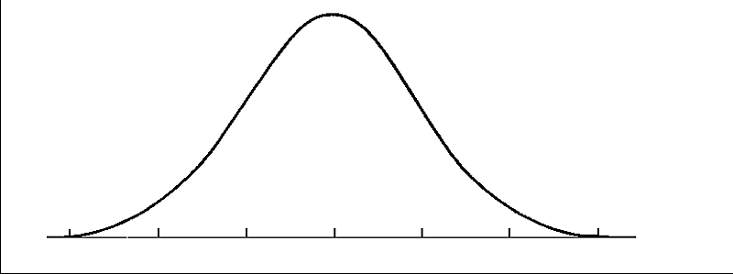
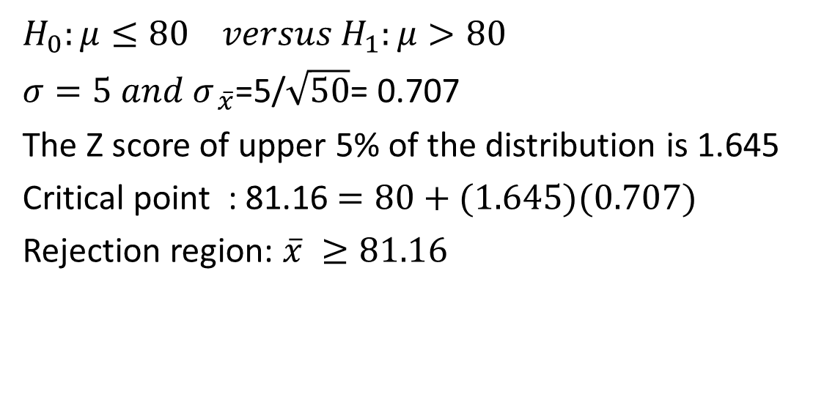


3.Caculating the Power
$$H_{0}:μ≤80 versus H_{1}:μ>80$$
$σ=5 and σ_{ \overline{x}}$=5/$\sqrt{50}$= 0.707
The Z score of upper 5% of the distribution is 1.645
Critical point : 81.16 $=80+(1.645)(0.707)$
Rejection region: $\overline{x} ≥81.16$
$$Null Distribution$$
Rejection region 5%
80
81.16
$$Z_{0}=1.645$$

Slide 8
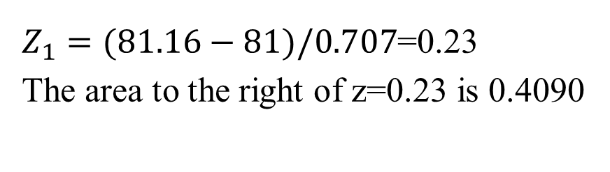




3.Caculating the Power
$Z_{1}=(81.16−81)/0.707$=0.23
The area to the right of z=0.23 is 0.4090
$$Null Distribution$$
$$Alternate Distribution$$
$$Power=0.490$$
80
81
81.16
$Z_{0}=1.645$ $Z_{1}=0.23$

Slide 9
3.Caculating the Power
A power of 0.4090 is very low.
If the mean yield of new process is actually equal to 81, there is only a 41% chance that the experiment did detect the improvement over the old process.
In general, tests with power greater than 80% or 90% are considered acceptable.

Slide 10












3.Caculating the Power
The power is larger when the value of$μ_{1}$is far from the null mean
$$Null Distribution$$
$$Alternate Distribution$$
$$Power=0.4090$$
$μ_{0}=$80
$μ_{1}$=81
81.16
$Z_{0}=1.645$ $Z_{1}=0.23$
$$Null Distribution$$
$$Alternate Distribution$$
$$Power=0.8830$$
$μ_{0}=$80
81.16
$μ_{1}$=82
$Z_{0}=1.645$ $Z_{1}=−1.19$

Slide 11





4.Caculating the sample size
In testing the hypothesis $H_{0}:μ≤80 versus H_{1}:μ>80.$ What is the sample size so that a test conducted at a significance level of 5% will have power 0.90 against the alternative µ=81. If it is assumed that $σ=5$.
80 + 1.645$\left(\frac{5}{\sqrt{n}}\right)$= 81 – 1.28$\left(\frac{5}{\sqrt{n}}\right)$
$$Null Distribution$$
$$Alternate Distribution$$
$$Power=0.90$$
80
80.56
81
$Z_{0}=1.645$ $Z_{1}=−1.28$

Slide 12
5.Using R to calculate the power or sample size
It is more difficult to compute power for a t test, F test, or Chi-square test. Therefore, we use pwr package in R to do the calculation.
Some of the more important functions are listed below.
function | power calculations for
pwr.2p.test | two proportions (equal n)
pwr.2p2n.test | two proportions (unequal n)
pwr.anova.test | balanced one way ANOVA
pwr.chisq.test | chi-square test
pwr.f2.test | general linear model
pwr.p.test | proportion (one sample)
pwr.r.test | correlation
pwr.t.test | t-tests (one sample, 2 sample, paired)
pwr.t2n.test | t-test (two samples with unequal n)

Slide 13
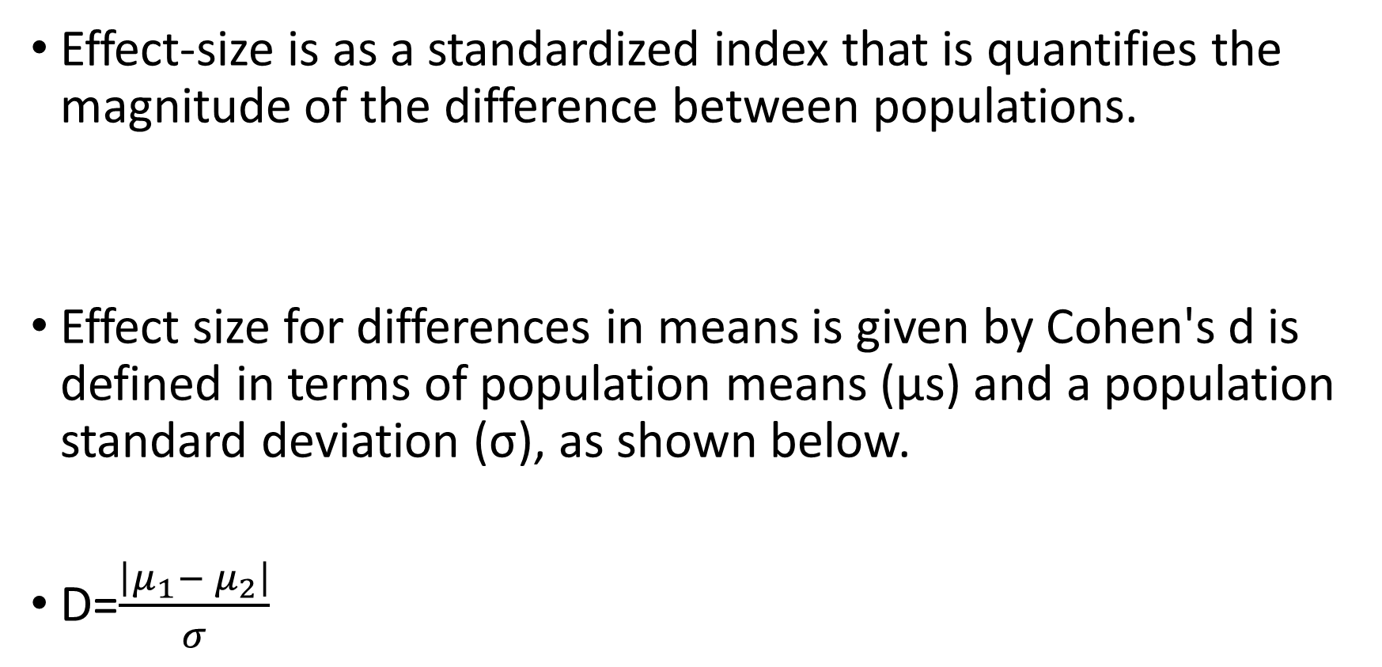
5.Using R to calculate the power or sample size
Effect-size is as a standardized index that is quantifies the magnitude of the difference between populations.
Effect size for differences in means is given by Cohen's d is defined in terms of population means (μs) and a population standard deviation (σ), as shown below.
D=$\frac{\left|μ_{1}− μ_{2}\right|}{σ}$

Slide 14
5.Using R to calculate the power or sample size
N=3
Female μ = 500
Male μ = 1500
σ = 44.72
N=3
Female μ = 50
Male μ = 150
σ = 14.14
Two-sample t test power calculation
n = 3
d = 7
sig.level = 0.05
power = 0.999973
alternative = two.sided
NOTE: n is number in *each* group
Two-sample t test power calculation
n = 3
d = 22.36
sig.level = 0.05
power = 1
alternative = two.sided
NOTE: n is number in *each* group

Slide 15
5.Using R to calculate the power or sample size
1.Fixed power to 0.9
2.Fixed sample size n = 3
If d = 0.5
n = 85.03126
d = 0.5, sig.level = 0.05, power = 0.9
If d = 0.5
n = 3, d = 0.5
sig.level = 0.05
power = 0.07684905
If d= 1
n = 22.02109
d = 1, sig.level = 0.05, power = 0.9
If d= 1
n = 3, d = 1
sig.level = 0.05
power = 0.1587909
If d=3
n = 3.624818
d = 3, sig.level = 0.05, power = 0.9
If d=3
n = 3, d = 3
sig.level = 0.05
power = 0.7825544

Slide 16
5.Using R to calculate the power or sample size
Example
Find the power for an independent-samples t-test at the 5% level of significance, with sample sizes of 20 and 80.
> pwr.t2n.test(d=0.6, n1 =20 , n2=80, sig.level = 0.05, power =NULL ,alternative = "two.sided")
t test power calculation
n1 = 20
n2 = 80
d = 0.6
sig.level = 0.05
power = 0.6614718
alternative = two.sided

